Slide 1

PYTHON
ENCAPSULATION

Slide 2

OBJECTIVES
About Encapsulation
Public, Private and Protected members.
Name Mangling

Slide 3
ENCAPSULATION
Encapsulation basically refers to bundling the attributes and methods within the single unit.
Class is also an example of encapsulation.
With Encapsulation we can create attributes and members such that they can’t be directly accessed.
Helps with information Hiding.
Hiding Method Implementation.
Prevent accidental data modification.

Slide 4
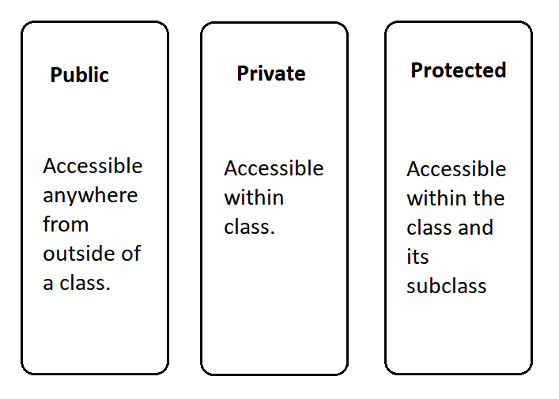

Slide 5
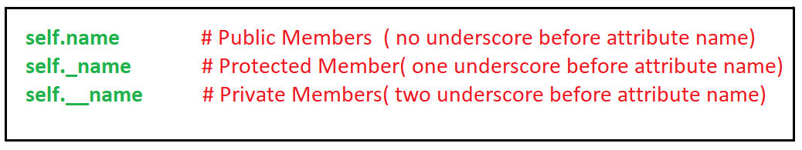
ENCAPSULATION:
Python does not have some special method to define the public, private and protected members instead we use the underscore methods to define the clearance of any attribute and method.

Slide 6
ACCESSING PRIVATE MEMBERS
Two Methods
Making a public method to access the private attributes.
Name Mangling.
Syntax for Name Mangling:
<object name>_classname__Member

Slide 7
ADVANTAGES OF ENCAPSULATION
DATA HANDLING
SECURITY
SIMPLICITY
READIBILITY

